Slide 1

Recommender Systems
DSLA Course
Rohit Padebettu

Slide 2
Recommender Systems

Slide 3
Applications
Traditionally people around us were recommendation engines

Slide 4
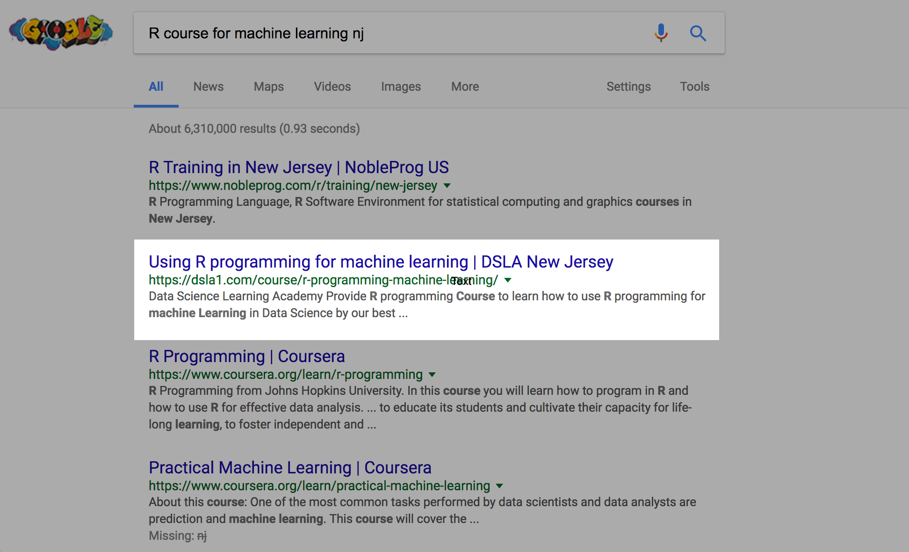
Applications
Google replaced everyone and recommends everything you ask for

Slide 5
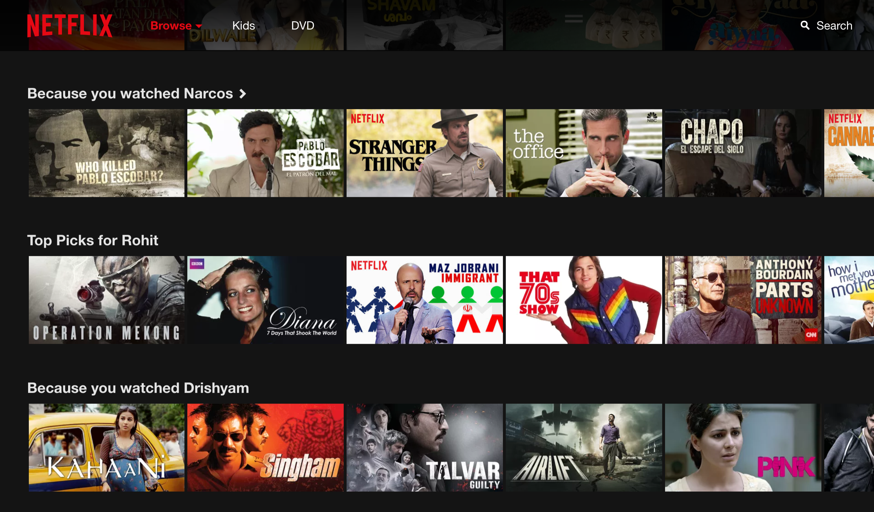
Applications
Netflix movies you may enjoy: Replaces friends you might have otherwise asked

Slide 6
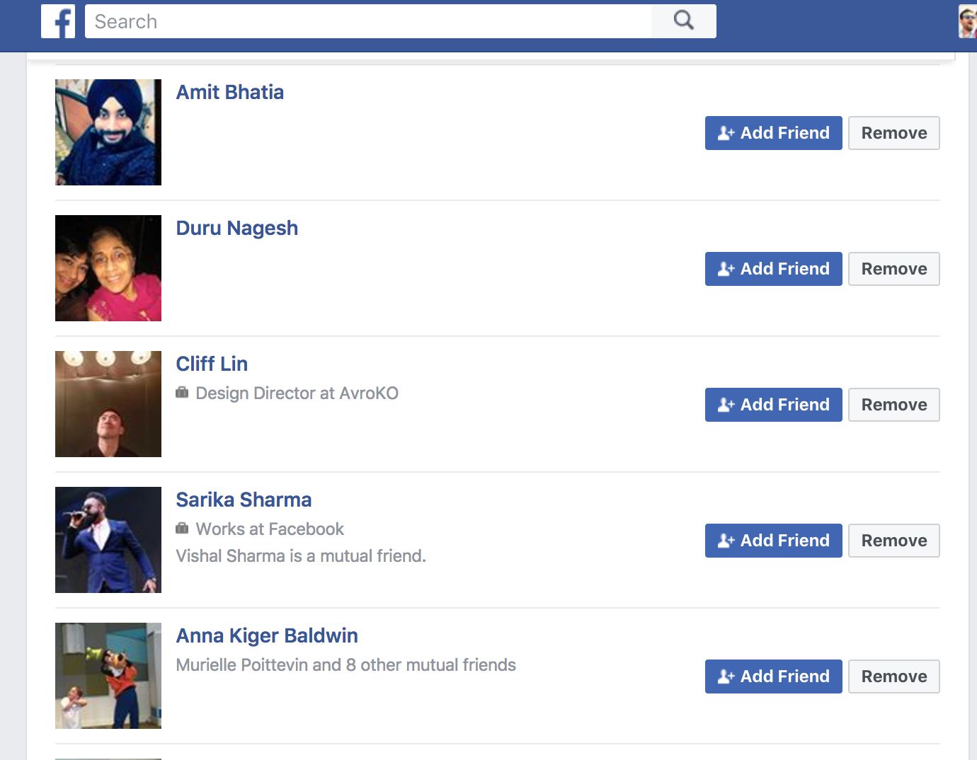
Applications
Facebook: Recommends new Friends you may make

Slide 7
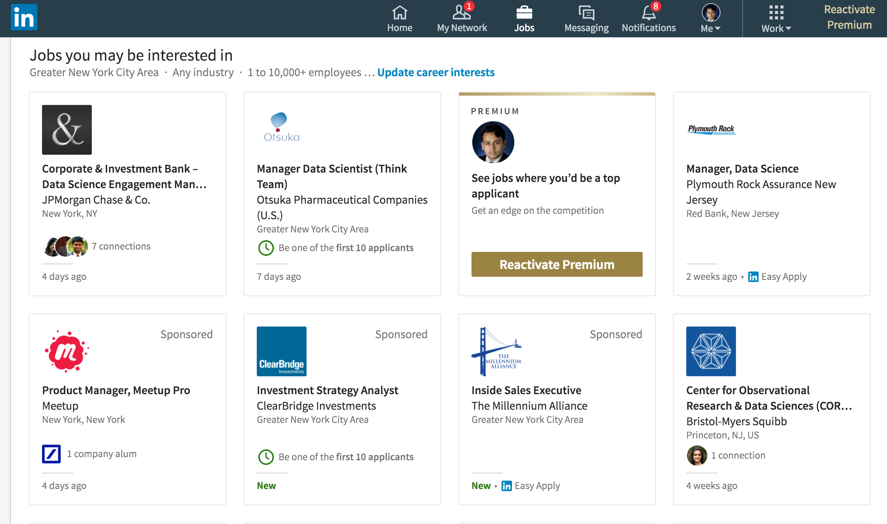
Applications
LinkedIn recommends jobs you maybe interested in

Slide 8
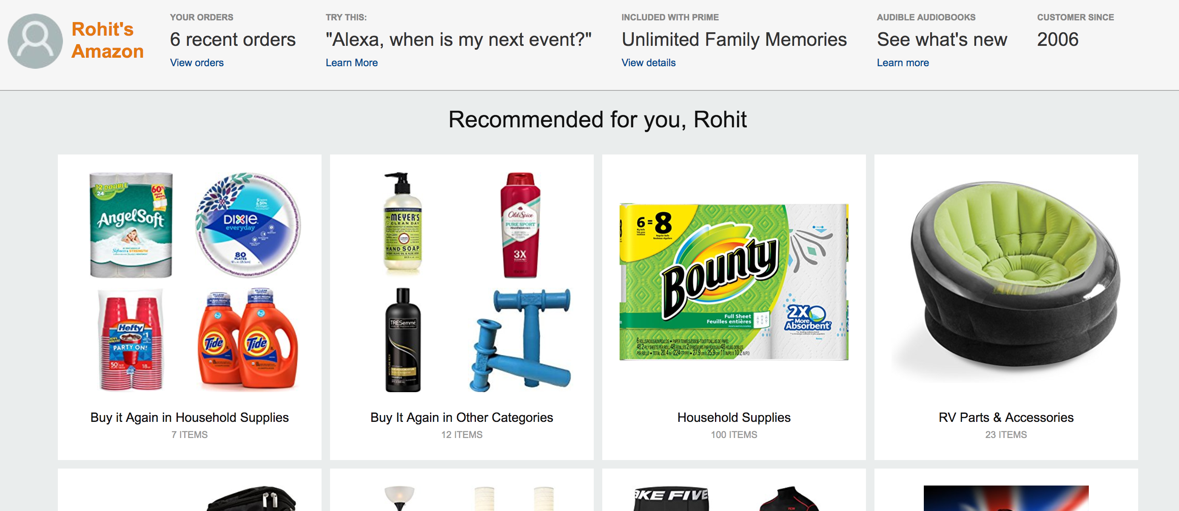
Applications
Amazon recommends stuff you can buy based on your buying habits

Slide 9
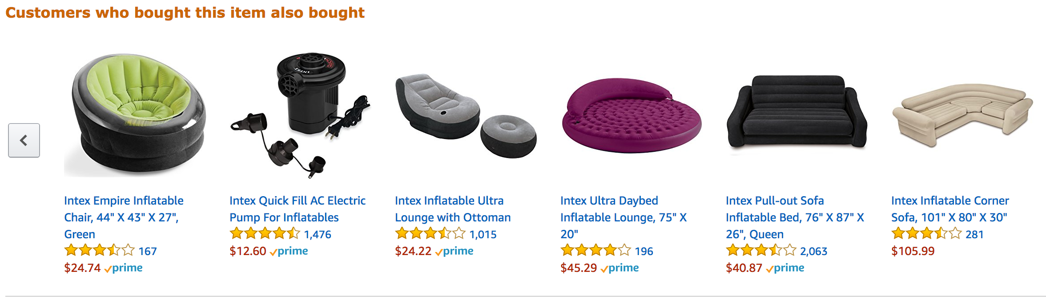
Applications
Amazon also recommends stuff you can buy based on others habits

Slide 10
Why Recommendation Engines ?

Slide 11
Recommender Systems
A recommender system or a recommendation system is a subclass of information filtering system that seeks to predict the "rating" or "preference" that a user would give to an item
- Wikipedia

Slide 12
Types of Recommender Systems
Recommender Systems
Content Based Filtering
Collaborative Filtering
Neighborhood Based
Hybrid Filtering
Model Based
Hybrid

Slide 13
Content Based Filtering
Are based on item features and user preferences
The system tries to predict based on user’s past behavior

Slide 14
Collaborative Filtering
Are based on large amount of data collected on many users preferences
The system tries to predict based on user similarity
and/or
item similarity
KNN or Pearson Correlation is used for similarity

Slide 15
Hybrid Filtering
Are based on combination of recommendations from both content based and collaborative filtering systems
Performs better
Overcomes problems such as cold start or data sparsity

Slide 16
Content Based Filtering
A Feature Profile
&
A User Profile
Are required to make predictions

Slide 17
CBF - Example
Step1 : Track the Users Engagement with the articles

Slide 18
CBF - Example
Step2 : Normalize features
1/SQRT(3)

Slide 19
CBF - Example
Step3 : Create User Profiles for each feature

Slide 20
CBF - Example
Step4 : Calculate Inverse Document Frequency (IDF)
Log(10/4) = 0.3979
Here we assume there are 10 such articles

Slide 21
CBF - Example
Step5 : Use user profiles & item profiles to create predictions
Multiply Item profile with IDF to get weighted article score vector.
Multiply that with user profile to get score for user per article

Slide 22
User Based Collaborative Filtering
Neighborhood Based Approach
Assume 6 users and 8 item matrix with cells representing ratings
Active User U_{a} has rated item 3,4,6 & 8. We need to predict ratings for item 1,2,5 & 7
We calculate user similarity to get 3 most similar users U₁,U₃,U₄
Cosine Similarity or Pearson Correlation of given ratings can be used
Missing Ratings for active user U_{a} are Average of existing ratings of similar users

Slide 23
Item Based Collaborative Filtering
Model Based Approach
Assume 6 users and 8 item matrix with cells representing ratings
Active User U_{a} has rated item 1,5 & 8. We need to predict ratings for item 2,3,4,6 & 7
We calculate item similarity from the 3 items rated by active user U_{a} against all other items
Cosine Similarity or Pearson Correlation can be used again
Missing Ratings are wtd average of similar item ratings filtered by a threshold
(2*0 + 4*0.4+5*0.5)/(0+0.4+0.5) = 4.6

Slide 24
Recommendation Systems
Demo

Slide 25
Recommendation Systems
Have good rest of weekend!

